Slide 1
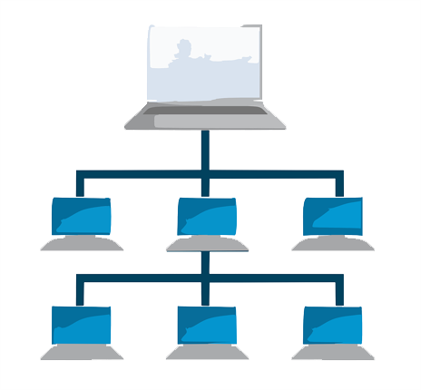
SPLIT-LOAD
An Efficient LAN Downloader

Slide 2




Team M*A(3)
Alka Prasad
Avnish Kumar
Mohit Kumar
Abhishek Das
Mentored By
Srimanta Kundu
Asst. Prof. Dept. of CSE
13000116138
13000116121
13000116094
13000216135

Slide 3

Problem Domain
Assumptionss
Computer Networks
No Bandwidth Limit per Connection
January 20XX
Multiple connections for an IP
File Download
Sharing Over LAN
LAN BW >>> ISP BW
Speed & Convenience
Visibility Over Ethernet

Slide 4





Solution
Pros
All clients work independently.
1
100 Mb
100 Mb
Cons.
Huge traffic.
Wastage of data.
High Manual Effort
Client-1
Client-3
Server
100 Mb
Client-2
Client-4
100 Mb
100 Mb
Naïve Solution
Complete file downloaded separately on each computer.

Slide 5
Solution
Pros
No wastage of data.
Better performance as bandwidth of LAN is better than that of ISP.
2
100 Mb
100 Mb
Client-1
Client-3
Server
Cons
High Manual Effort.
Data loss if master computer faces any error.
Inefficient Bandwidth usage.
100 Mb
Client-2
Client-4
100 Mb
100 Mb
Better solution.
File once downloaded can be shared on the LAN.

Slide 6
Our proposed Solution
Work-Flow
Master Computer requests file.
Server responds with meta-data
Master Computer assigns parts.
Each node requests connection.
Parts of the file are downloaded separately.
Sharing of packets while downloading.
Merging of data after downloading.
25 Mb
25 Mb
Client-1
Client-3
Server
100 Mb
Client-2
Client-4
25 Mb
25 Mb

Slide 7
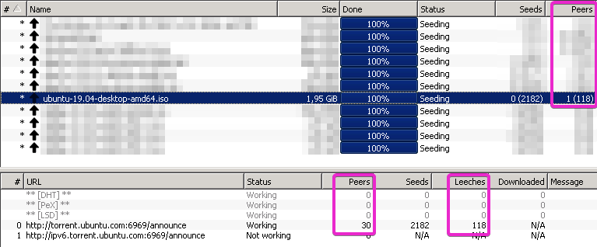
Torrent
Peer: Incomplete Download
Seed: Complete Download
Uses Tit-for-Tat algorithm
Transfer Between
Peer to Peer
Peer to Seed
Trackers
Notes:
Peers: System who hasn’t completed the download. Seed: Who Completed the download.
Decentralized peer-to-peer protocol : Instead of requesting file from a central server, it request it from other Peers in the swarm.
How will then know which peer to connect with? Here comes tracker.
The tracker is a special server that keeps track of the connected computers.
Downloading and Seeding works on a chunk level, instead of full file. So based on the seeding latency of chunks it will req the chunks from other peers.

Slide 8
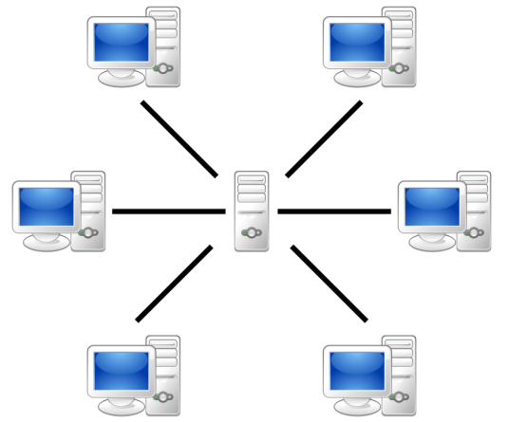
How Torrent works
Centralized Server System
Decentralized peer-to-peer protocol
Contacts other peers in the swarm, and begins downloading
Peer maintains
contact with
the tracker
Example: NIC
Example: Bit Torrent

Slide 9
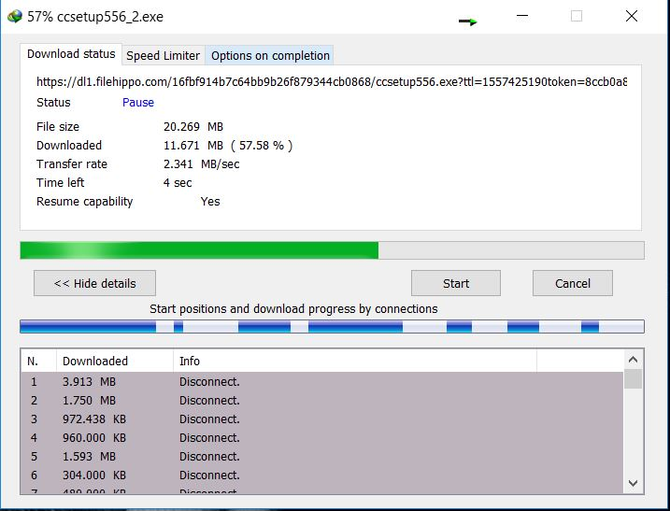
How IDM works
Divides the download process in many threads.
Each thread downloads some part
Parts are merged.
Efficient for one computer.

Slide 10


PROTOTYPE BUILDING

Slide 11
Connection Setup
Master broadcasts a message to start the download of a file
Ready
Those systems ready for download, requests a TCP connection with the master
Ready
Master
Ready
The master accepts the connection requests and then ends the broadcast
Ready

Slide 12
Downloading
Master gets the download link and divides it amongst the clients
Master shares this information with the clients using TCP connection
Systems start the download.

Slide 13
Sharing
Clients create a mesh TCP network
All the systems start sharing the file while it is downloading

Slide 14

Merging
Merging of files start after all systems have shared the parts of the file
All the systems start merging the files together
Finally, we have the whole file downloaded in all systems

Slide 15
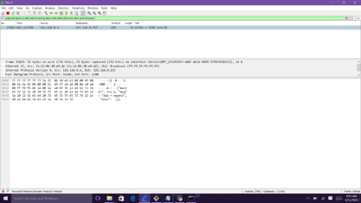
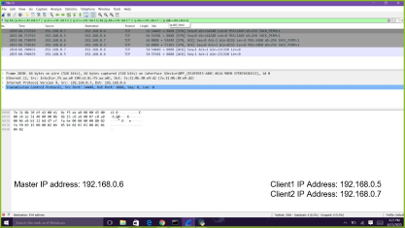
Wireshark Snippets

Slide 16
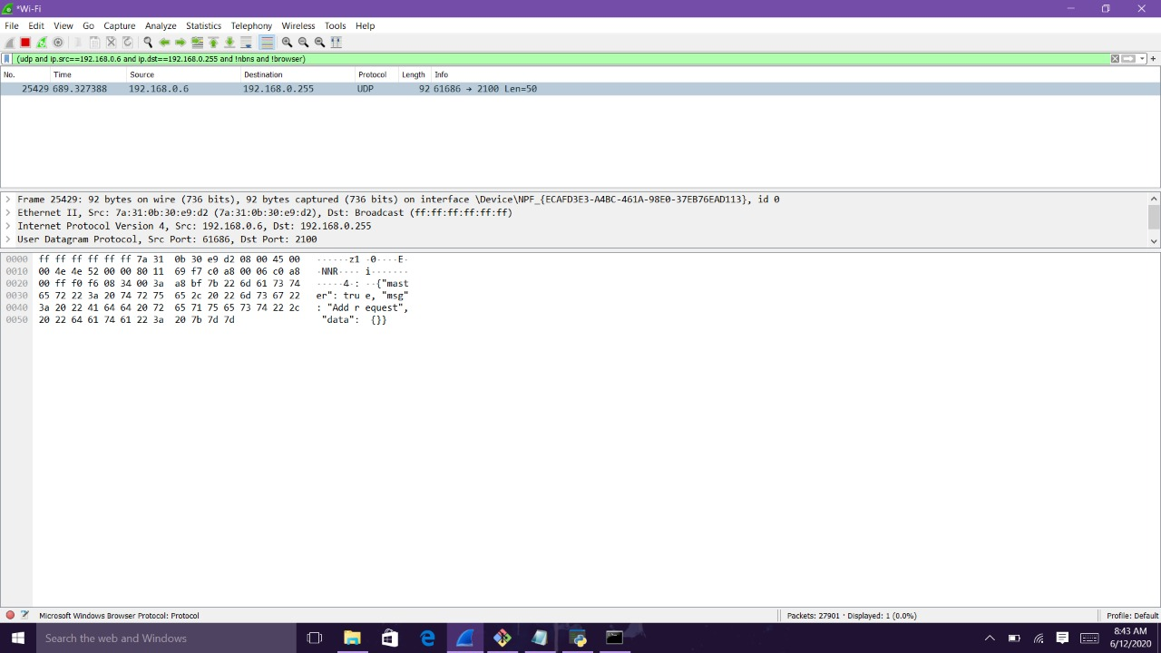

Slide 17
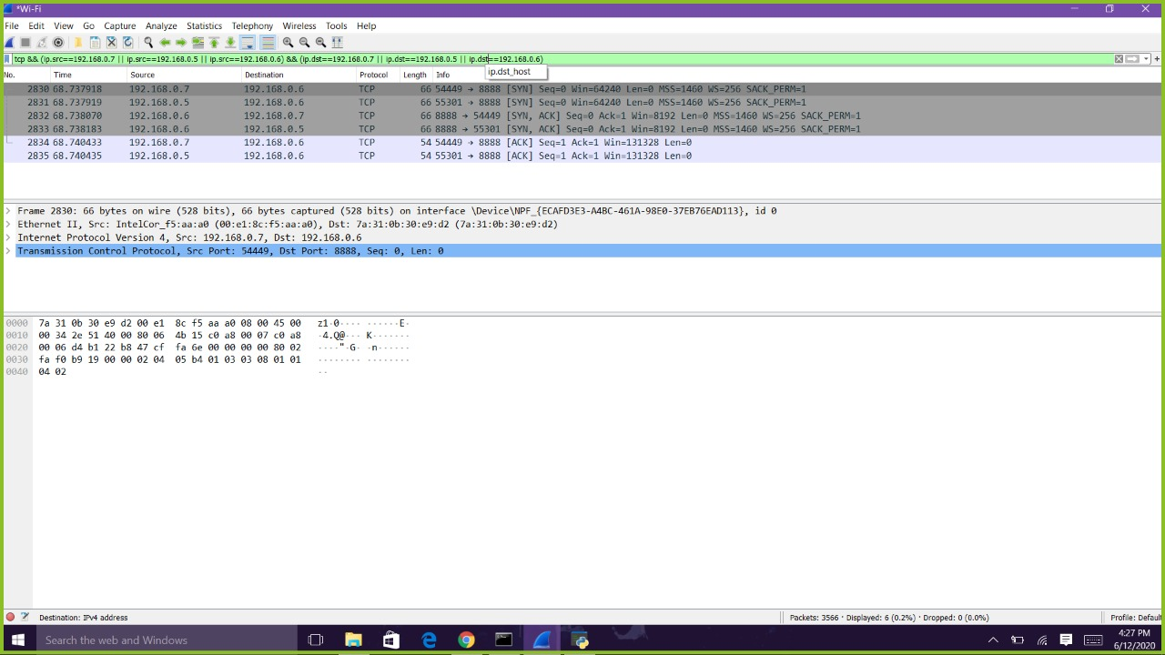
Master IP address: 192.168.0.6
Client1 IP Address: 192.168.0.5
Client2 IP Address: 192.168.0.7

Slide 18
SWOT Analysis
S
Enhances Download Speed
Uniqueness of the idea
Utilizes complete bandwidth
Reduces manual effort
W
After sharing of download link, if any system stops working the file will not be downloaded in any system
If any system becomes slow, the downloading and sharing efficiency of the overall project will decrease
O
Development of mobile application for SplitLoad to download and share files among group of people with handheld devices
T
If IDM extends its solution similar to ours, then it can become our big competitor

Slide 19
Future Scope
Develop an algorithm to distribute the load in case a node(s) crashes.
Support of simultaneous multiple file downloads.
Enhancement of User Interface and User Experience.
Creation of Custom Protocol to enhance sharing speed.
Detect poor performing systems.

Slide 20

Project Plan
Requirement Matrix

